Slide 1
Creating an XML Document

Slide 2
Introducing XML
XML stands for Extensible Markup Language. A markup language specifies the structure and content of a document.
Because it is extensible, XML can be used to create a wide variety of document types.

Slide 3
Introducing XML
XML is a subset of the Standard Generalized Markup Language (SGML) which was introduced in the 1980s. SGML is very complex and can be costly. These reasons led to the creation of Hypertext Markup Language (HTML), a more easily used markup language. XML can be seen as sitting between SGML and HTML – easier to learn than SGML, but more robust than HTML.

Slide 4
The Limits of HTML
HTML was designed for formatting text on a Web page. It was not designed for dealing with the content of a Web page. Additional features have been added to HTML, but they do not solve data description or cataloging issues in an HTML document.
Because HTML is not extensible, it cannot be modified to meet specific needs. Browser developers have added features making HTML more robust, but this has resulted in a confusing mix of different HTML standards.

Slide 5
Introducing XML
HTML cannot be applied consistently. Different browsers require different standards making the final document appear differently on one browser compared with another.

Slide 6
The 10 Primary XML Design Goals
XML must be easily usable over the Internet
XML must support a wide variety of applications
XML must be compatible with SGML
It must be easy to write programs that process XML documents
The number of optional features in XML must be kept small

Slide 7
The 10 Primary XML Design Goals Continued
XML documents should be clear and easily understood
The XML design should be prepared quickly
The design of XML must be exact and concise
XML documents must be easy to create
Keeping an XML document size small is of minimal importance

Slide 8
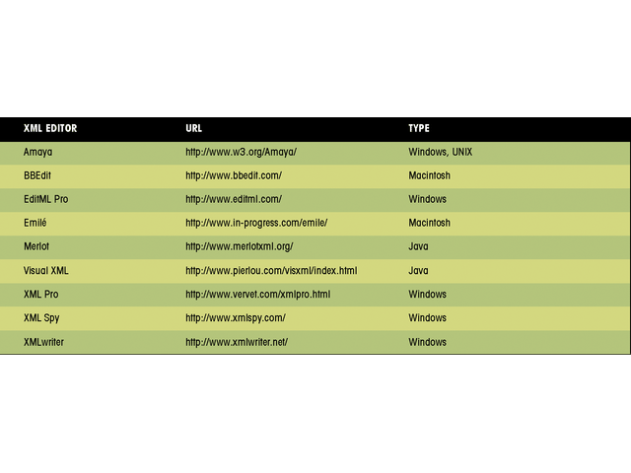
XML Editors
This figure shows available XML editors

Slide 9
XML Parsers
An XML processor (also called XML parser) evaluates the document to make sure it conforms to all XML specifications for structure and syntax.
There are two categories of XML documents
  Well-formed
  Valid

Slide 10
XML Parsers
Microsoft’s parser is called MSXML and is built into for IE versions 5.0 and above.
Netscape developed its own parser, called Mozilla, which is built into version 6.0 and above.

Slide 11
Well-Formed and Valid XML Documents
An XML document is well-formed if it contains no syntax errors and fulfills all of the specifications for XML code as defined by the W3C.
An XML document is valid if it is well-formed and also satisfies the rules laid out in the DTD or schema attached to the document.

Slide 12
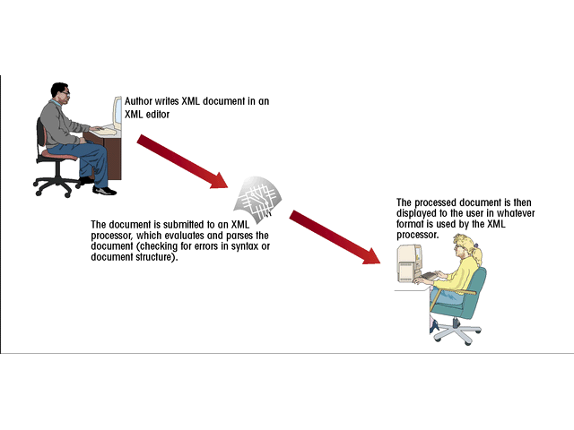
The Document Creation Process
This figure shows the document creation process

Slide 13
Working with XML Applications
XML has the ability to create markup languages, called XML applications. Many have been developed to work with specific types of documents.
Each application uses a defined set of tag names called a vocabulary. This makes it easier to exchange information between different organizations and computer applications.

Slide 14
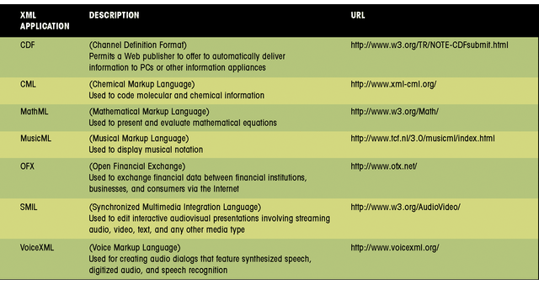
XML Applications
This figure shows some XML applications

Slide 15
The Structure of an XML Document
XML documents consist of three parts
  The prolog
  The document body
  The epilog
The prolog is optional and provides information about the document itself

Slide 16
The Structure of an XML Document
The document body contains the document’s content in a hierarchical tree structure.
The epilog is also optional and contains any final comments or processing instructions.

Slide 17
The Structure of an XML Document: Creating the Prolog
The prolog consists of four parts in the following order:
  XML declaration
  Miscellaneous statements or comments
  Document type declaration
  Miscellaneous statements or comments
This order has to be followed or the parser will generate an error message.
None of these four parts is required, but it is good form to include them.

Slide 18
The Structure of an XML Document: The XML Declaration
The XML declaration is always the first line of code in an XML document. It tells the processor what follows is written using XML. It can also provide any information about how the parser should interpret the code.
The complete syntax is:
  <?xml version=“version number” encoding=“encoding type” standalone=“yes | no” ?>
A sample declaration might look like this:
  <?xml version=“1.0” encoding=“UTF-8” standalone=“yes” ?>

Slide 19
The Structure of an XML Document: Inserting Comments
Comments or miscellaneous statements go after the declaration. Comments may appear anywhere after the declaration.
The syntax for comments is:
  <!- - comment text - ->
This is the same syntax for HTML comments

Slide 20
Elements and Attributes
Elements are the basic building blocks of XML files.
XML supports two types of elements:
  Closed
  empty (also called open)

Slide 21
Elements and Attributes
A closed element, has the following syntax:
  <element_name>Content</element_name>
Example:
  <Artist>Miles Davis</Artist>

Slide 22
Elements and Attributes
Element names are case sensitive
Elements can be nested, as follows:
  <CD>Kind of Blue
    <TRACK>So What ((:22)</TRACK>
    <TRACK>Blue in Green (5:37)</TRACK>
  </CD>

Slide 23
Elements and Attributes
Nested elements are called child elements.
Elements must be nested correctly. Child elements must be enclosed within their parent elements.

Slide 24
Elements and Attributes
All elements must be nested within a single document or root element. There can be only one root element.
An open or empty element is an element that contains no content. They can be used to mark sections of the document for the XML parser.

Slide 25
Elements and Attributes
An attribute is a feature or characteristic of an element. Attributes are text strings and must be placed in single or double quotes. The syntax is:
  <element_name attribute=“value”> … </element_name>

Slide 26
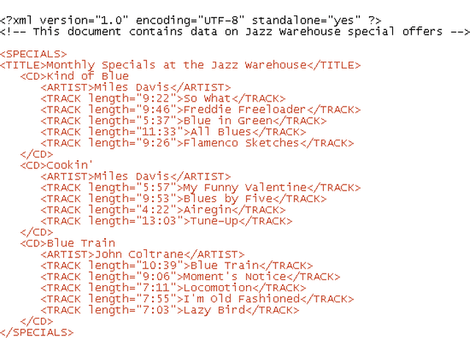
Elements and Attributes: Adding elements to the Jazz.XML File
This figure shows the revised document
{
prolog
document elements

Slide 27
Character References
Special characters, such as the symbol for the British pound, can be inserted into your XML document by using a character reference. The syntax is:
  &#character;

Slide 28
Character References
Character is a character reference number or name from the ISO/IEC character set.
Character references in XML are the same as in HTML.

Slide 29
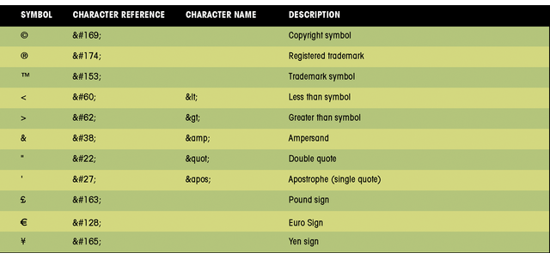
Character References
This figure shows commonly used character reference numbers

Slide 30
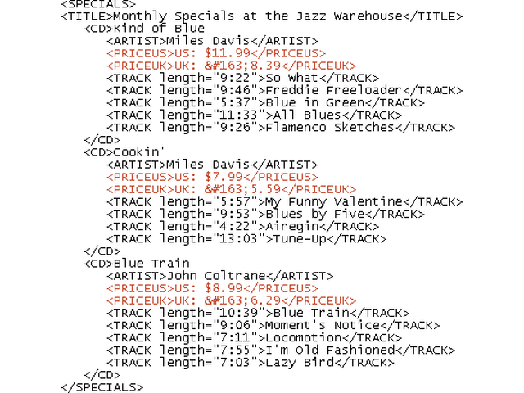
Character References
This figure shows the revised Jazz.XML file
character reference

Slide 31
CDATA Sections
A CDATA section is a large block of text the XML processor will interpret only as text.
The syntax to create a CDATA section is:
  <! [CDATA [
    Text Block
  ] ]>

Slide 32
CDATA Sections
In this example, a CDATA section stores several HTML tags within an element named HTMLCODE:
<HTMLCODE>
<![CDATA[
<h1>The Jazz Warehouse</h1>
<h2>Your Online Store for Jazz Music</h2>
] ]>
</HTMLCODE>

Slide 33
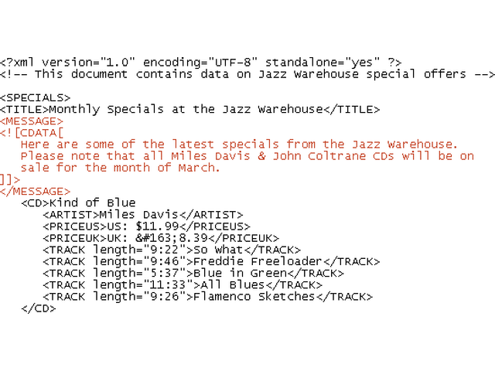
CDATA Sections
This figure shows the revised Jazz.XML file
CDATA section

Slide 34
Displaying an XML Document in a Web Browser
XML documents can be opened in Internet Explorer or in Netscape Navigator.
If there are no syntax errors. IE will display the document’s contents in an expandable/collapsible outline format including all markup tags.
Netscape will display the contents but neither the tags nor the nested elements.

Slide 35
Displaying an XML Document in a Web Browser
To display the Jazz.xml file in a Web browser:
  1. Start the browser and open the Jazz.xml file located in the Tutorial.01/Tutorial folder of your Data Disk.
  2. Click the minus (-) symbols.
  3. Click the resulting plus (+) symbols.

Slide 36
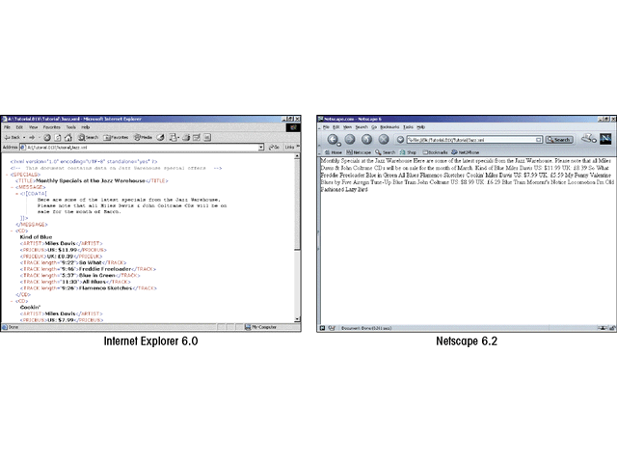
Displaying an XML Document in a Web Browser
This figure shows the revised Jazz.XML file as seen in Internet Explorer 6.0 and Netscape 6.2

Slide 37
Linking to a Style Sheet
Link the XML document to a style sheet to format the document. The XML processor will combine the style sheet with the XML document and apply any formatting codes defined in the style sheet to display a formatted document.
There are two main style sheet languages used with XML:
  Cascading Style Sheets (CSS) and Extensible Style Sheets (XSL)

Slide 38
Linking to a Style Sheet
There are some important benefits to using style sheets:
  By separating content from format, you can concentrate on the appearance of the document
  Different style sheets can be applied to the same XML document
  Any style sheet changes will be automatically reflected in any Web page based upon the style sheet

Slide 39
Applying a Style to an Element
To apply a style sheet to a document, use the following syntax:
  selector {attribute1:value1; attribute2:value2; …}
selector is an element (or set of elements) from the XML document.
attribute and value are the style attributes and attribute values to be applied to the document.

Slide 40
Applying a Style to an Element
For example:
  ARTIST {color:red; font-weight:bold}
will display the text of the ARTIST element in a red boldface type.

Slide 41
Creating Processing Instructions
The link from the XML document to a style sheet is created using a processing statement.
A processing instruction is a command that gives instructions to the XML parser.

Slide 42
Creating Processing Instructions
For example:
  <?xml-stylesheet type=“style” href=“sheet” ?>
Style is the type of style sheet to access and sheet is the name and location of the style sheet.

Slide 43
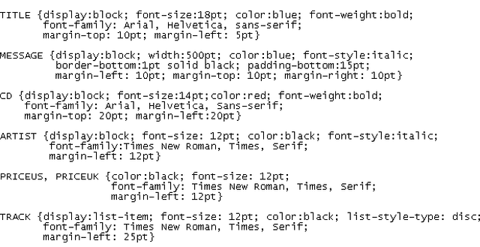
The JW.css Style Sheet
This figure shows the cascading style sheet stored in the JW.css file

Slide 44
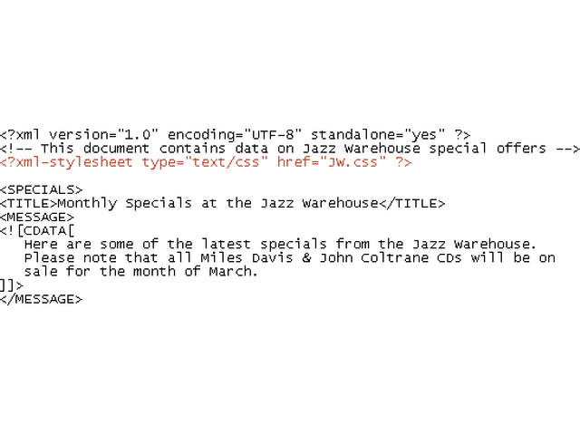
Linking to the JW.css Style Sheet
This figure shows how to link the JW.css style sheet to the Jazz.xml file
processing instruction to access the JW.css style sheet

Slide 45
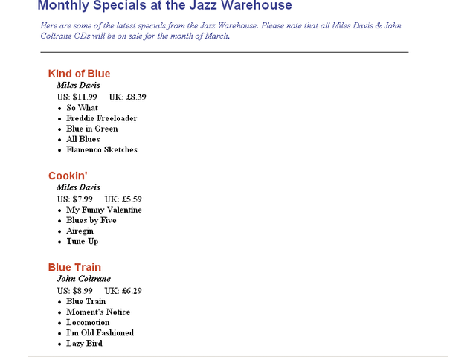
The Jazz.xml Document Formatted with the JW.css Style Sheet
This figure shows the formatted Jazz.XML file

